Slide 1
LG BOOSTING
LG boosting or LightGradient Boosting.
Can handle large datasets with millions of rows and columns

Slide 2
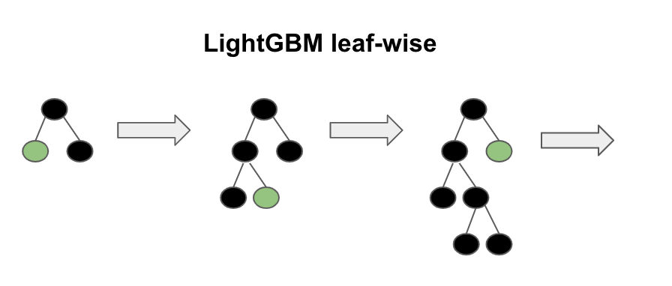

Slide 3
The leaf-wise algorithm can reduce more loss than the level-wise algorithm.
It is optimized for high performance with distributed systems.

Slide 4
LG boosting uses bundling in which the algorithm combines exclusive features to reduce dimensionality, making it faster.

Slide 5
LGboost advantage, disadvantage and applications:
Advantage:
Better accuracy than any other algorithm
Low memory usage
Disadvantage:
Overfitting and Compatibility with Datasets
Applications:
Data science application development.

